Slide 1

Optimization Algorithms
Mini-batch
gradient descent
deeplearning.ai

Slide 2
Batch vs. mini-batch gradient descent
Vectorization allows you to efficiently compute on m examples.

Slide 3
Mini-batch gradient descent

Slide 4
Optimization Algorithms
Understanding
mini-batch
gradient descent
deeplearning.ai

Slide 5
Training with mini batch gradient descent
Batch gradient descent
Mini-batch gradient descent
cost
cost
# iterations
mini batch # (t)

Slide 6
Choosing your mini-batch size

Slide 7
Choosing your mini-batch size

Slide 8
Optimization Algorithms
Exponentially weighted averages
deeplearning.ai

Slide 9
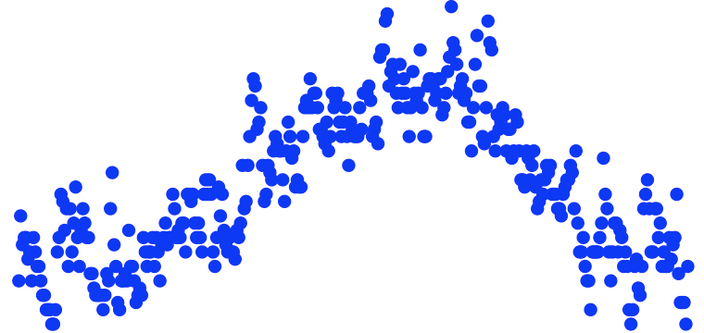
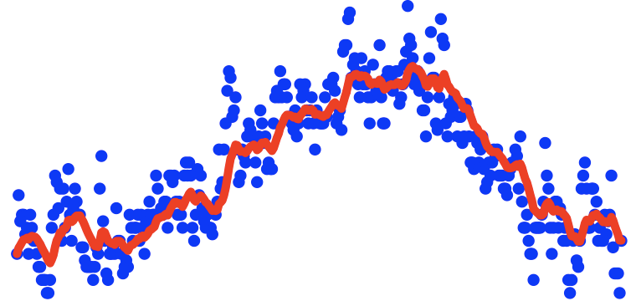
Temperature in London
$$θ_{1}=40°F$$
$$θ_{2}=49°F$$
$$θ_{3}=45°F$$
temperature
.
.
.
$$θ_{180}=60°F$$
$$θ_{181}=56°F$$
days
.
.
.

Slide 10
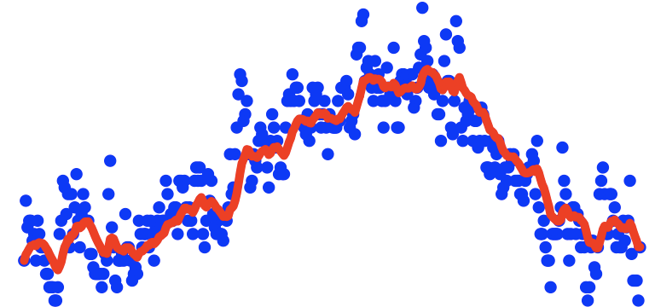
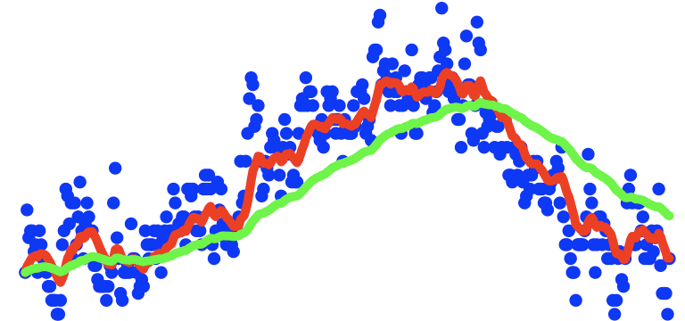
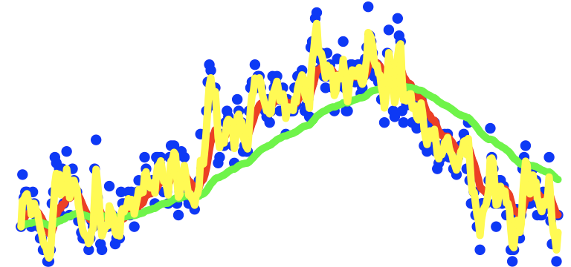
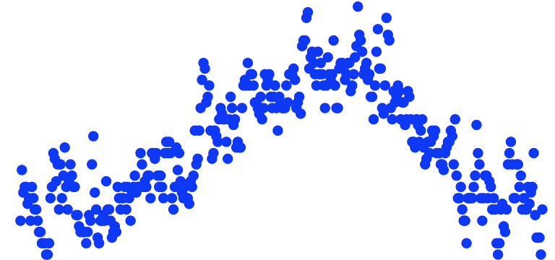
Exponentially weighted averages
temperature
days

Slide 11
Optimization Algorithms
Understanding exponentially weighted averages
deeplearning.ai

Slide 12
Exponentially weighted averages
$$v_{t}=βv_{t−1}+(1−β)θ_{t}$$
temperature
days

Slide 13
Exponentially weighted averages
$$v_{t}=βv_{t−1}+(1−β)θ_{t}$$
$$v_{100}=0.9v_{99}+0.1θ_{100}$$
$$v_{99}=0.9v_{98}+0.1θ_{99}$$
$$v_{98}=0.9v_{97}+0.1θ_{98}$$
$$…$$

Slide 14
Implementing exponentially weighted averages
$$v_{0}=0$$
$$v_{1}=βv_{0}+(1−β) θ_{1}$$
$$v_{2}=βv_{1}+(1−β) θ_{2}$$
$$v_{3}=βv_{2}+(1−β) θ_{3}$$
$$…$$

Slide 15
Optimization Algorithms
Bias correction
in exponentially
weighted average
deeplearning.ai

Slide 16
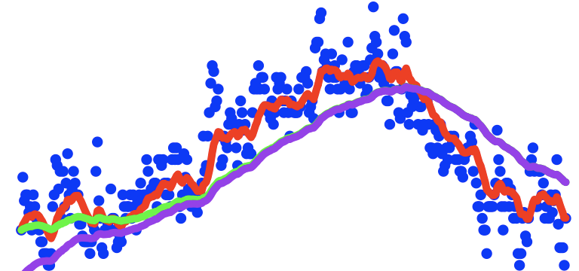
Bias correction
temperature
days
$$v_{t}=βv_{t−1}+(1−β)θ_{t}$$

Slide 17
Optimization Algorithms
Gradient descent with momentum
deeplearning.ai

Slide 18
Gradient descent example

Slide 19
Implementation details
$$On iteration t:$$
Compute $dW,db$on the current mini-batch
$$v_{dW}=βv_{dW}+\left(1−β\right)dW$$
$$v_{db}=βv_{db}+\left(1−β\right)db$$
$$W=W−αv_{dW},$$
$$b=b−αv_{db}$$
Hyperparameters: $α,β$
$$β=0.9$$

Slide 20
Optimization Algorithms
RMSprop
deeplearning.ai

Slide 21
RMSprop

Slide 22
Optimization Algorithms
Adam optimization
algorithm
deeplearning.ai

Slide 23
Adam optimization algorithm

Slide 24

Hyperparameters choice:
Adam Coates

Slide 25
Optimization Algorithms
Learning rate
decay
deeplearning.ai

Slide 26
Learning rate decay

Slide 27
Learning rate decay

Slide 28
Other learning rate decay methods

Slide 29
Optimization Algorithms
The problem of
local optima
deeplearning.ai

Slide 30
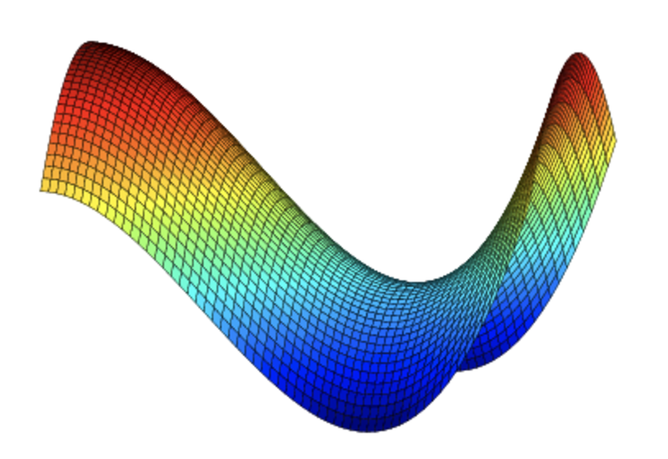
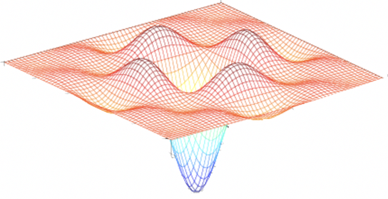
Local optima in neural networks

Slide 31

Problem of plateaus
Unlikely to get stuck in a bad local optima
Plateaus can make learning slow

